Slide 1
UNIT-4
Structured Query Language (SQL)

Slide 2
What is SQL?
SQL is Structured Query Language, which is a computer language for storing, manipulating and retrieving data stored in a relational database.
SQL is the standard language for Relational Database System. All the Relational Database Management Systems (RDMS) like MySQL, MS Access, Oracle, Sybase, Informix, Postgres and SQL Server use SQL as their standard database language.
Also, they are using different dialects, such as −
MS SQL Server using T-SQL,
Oracle using PL/SQL,
MS Access version of SQL is called JET SQL (native format) etc.

Slide 3
Why SQL?
SQL is widely popular because it offers the following advantages −
Allows users to access data in the relational database management systems.
Allows users to describe the data.
Allows users to define the data in a database and manipulate that data.
Allows to embed within other languages using SQL modules, libraries & pre-compilers.
Allows users to create and drop databases and tables.
Allows users to create view, stored procedure, functions in a database.
Allows users to set permissions on tables, procedures and views.

Slide 4
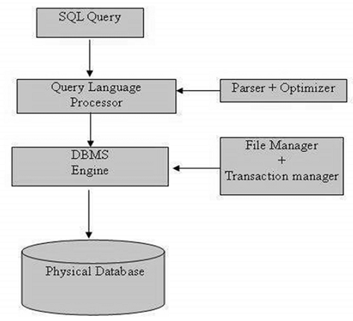
SQL Process: Following is a simple diagram showing the SQL Architecture

Slide 5
SQL follows the following rules:
Structure query language is not case sensitive. Generally, keywords of SQL are written in uppercase.
Statements of SQL are dependent on text lines. We can use a single SQL statement on one or multiple text line.
Using the SQL statements, you can perform most of the actions in a database.
SQL depends on tuple relational calculus and relational algebra.

Slide 6
SQL Commands
SQL commands are instructions. It is used to communicate with the database. It is also used to perform specific tasks, functions, and queries of data.
SQL can perform various tasks like create a table, add data to tables, drop the table, modify the table, set permission for users.

Slide 7
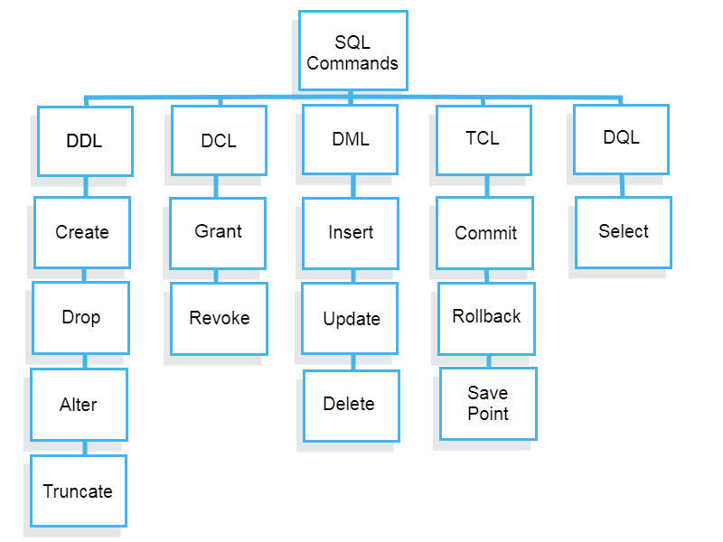

Slide 8
What is DDL?
Data definition language is set of commands used to Create, Modify or Drop various database objects such as tables, views, synonyms etc.
DDL changes the structure of the table like creating a table, deleting a table, altering a table, etc.
All the command of DDL are auto-committed that means it permanently save all the changes in the database.
Here are some commands that come under DDL:
CREATE
ALTER
DROP
TRUNCATE

Slide 9
CREATE It is used to create a new table in the database.
An SQL relation is defined using the create table command:
create table r (A₁ D₁, A₂ D₂, ..., A_{n} D_{n}, (integrity-constraint₁), ..., (integrity-constraint_{k}))
r is the name of the relation
each A_{i} is an attribute name in the schema of relation r
D_{i} is the data type of attribute A_{i}
Example:
create table branch (branch_name char(15), branch_city char(30), assets integer);

Slide 10
Domain Types in SQL
char(n). Fixed length character string, with user-specified length n.
varchar(n). Variable length character strings, with user-specified maximum length n.
int. Integer (a finite subset of the integers that is machine-dependent).
smallint. Small integer (a machine-dependent subset of the integer domain type).
numeric(p,d). Fixed point number, with user-specified precision of p digits, with n digits to the right of decimal point.
real, double precision. Floating point and double-precision floating point numbers, with machine-dependent precision.
float(n). Floating point number, with user-specified precision of at least n digits.

Slide 11
Drop and Alter Table Constructs
The drop table command deletes all information about the dropped relation from the database.
The alter table command is used to add attributes to an existing relation:
alter table r add A D
where - A is the name of the attribute to be added to relation r
- D is the domain of A.
All tuples in the relation are assigned null as the value for the new attribute.
The alter table command can also be used to drop attributes of a relation:
alter table r drop A
where A is the name of an attribute of relation r
Dropping of attributes not supported by many databases

Slide 12
TRUNCATE: It is used to delete all the rows from the table and free the space containing the table.
Syntax:
TRUNCATE TABLE table_name;
Example:
TRUNCATE TABLE EMPLOYEE;

Slide 13
Data Manipulation Language
DML commands are used to modify the database. It is responsible for all form of changes in the database.
The command of DML is not auto-committed that means it can't permanently save all the changes in the database. They can be rollback.

Slide 14
DML - INSERT
Inserting Data / Values into a table :
All rows in a table are inserted using the INSERT command
Syntax :
INSERT INTO <table name> [(col1, col2, ….)]
VALUES (<list of values>);

Slide 15
DML - INSERT
Values for all the columns or selected columns can be inserted
If column names are omitted the values should be in exactly same order
Columns that exists in the table but that are not listed in the INSERT default to NULL
Character & Date data is enclosed within single quotes
NULL values are given as NULL

Slide 16
Example :
INSERTING ALL values
INSERT INTO emp VALUES (7315, `JOHN’, `CLERK’, 7801, `10-Jun-97’, 2500, NULL, 30);
Inserting only some values
INSERT INTO emp (empno, ename,sal) VALUES (8234, `SAMUEL’, 6000);

Slide 17
Examples :
Insert a row into emp table using parameters substitution.
INSERT INTO emp VALUES (&empno, ‘&ename’, ‘&job’, &mgr, ‘&hiredate’, &salary, NULL, &deptno);

Slide 18
DML - UPDATE
UPDATE command is used to modify column values in table
Values of a single column or a group of columns can be updated
Updation can be carried out for all the rows in a table or selected rows (using WHERE clause)

Slide 19
Syntax :
UPDATE <table_name>
SET <colname> = <value>
[WHERE <condition>];
Subqueries can also be used with the UPDATE Command

Slide 20
DML - DELETE
Rows can be deleted using DELETE statement
The entire row is deleted from the table
Set of rows can also be deleted from a table by specifying the condition(s)
Syntax :
DELETE FROM <table_name>
[WHERE<condition>];
If WHERE clause is not specified all the rows will be deleted

Slide 21
Data Query Language
DQL is used to fetch the data from the database.
It uses only one command:
SELECT: This is the same as the projection operation of relational algebra. It is used to select the attribute based on the condition described by WHERE clause.
Syntax:
SELECT expressions
FROM TABLES
WHERE conditions;
For example:
SELECT emp_name
FROM employee
WHERE age > 20;

Slide 24
Data control language (DCL) is used to access the stored data.
It is mainly used for revoke and to grant the user the required access to a database.
In the database, this language does not have the feature of rollback.
It is a part of the structured query language (SQL).
It helps in controlling access to information stored in a database. It complements the data manipulation language (DML) and the data definition language (DDL).
It is the simplest among three commands.
It provides the administrators, to remove and set database permissions to desired users as needed.
These commands are employed to grant, remove and deny permissions to users for retrieving and manipulating a database.

Slide 25
DCL Commands (Data Control Language)
useful to give “rights & permissions.”
GRANT Command
It is employed to grant a privilege to a user. GRANT command allows specified users to perform specified tasks.
Syntax
Here,
privilege names are SELECT,UPDATE,DELETE,INSERT,ALTER,ALL
objectname is table name
user is the name of the user to whom we grant privileges
GRANT privilege_name on objectname to user;

Slide 26
GRANT privilege_name on objectname to user;
Explanation − Firstly, to give the permissions to user, we have to use GRANT command. The privileges are SELECT because to view the records and UPDATE to modify the records. The objectname is table name which is Employee. The user name is bhanu.
GRANT SELECT, UPDATE ON employees TO Bhanu

Slide 27
REVOKE Command
It is employed to remove a privilege from a user. REVOKE helps the owner to cancel previously granted permissions.
Syntax
Here,
privilege names are SELECT,UPDATE,DELETE,INSERT,ALTER,ALL
objectname is table name
user is the name of the user whose privileges are removing
REVOKE privilege_name on objectname from user;

Slide 28
REVOKE privilege_name on objectname from user;
Explanation − Firstly, to revoke the permissions to user, we have to use REVOKE command. The privileges Need to revoke are SELECT because to view the records and UPDATE to modify the records. The objectname is table name which is Employee. The user name is Bhanu.
REVOKE SELECT, UPDATE ON employees TO Bhanu

Slide 29
Transaction Control Language
TCL commands can only use with DML commands like INSERT, DELETE and UPDATE only.
These operations are automatically committed in the database that's why they cannot be used while creating tables or dropping them.
Here are some commands that come under TCL:
COMMIT
ROLLBACK
SAVEPOINT

Slide 30
What are Transactions?
Transactions group a set of tasks into a single execution unit. Each transaction begins with a specific task and ends when all the tasks in the group successfully complete.
If any of the tasks fail, the transaction fails. Therefore, a transaction has only two results: success or failure.
Incomplete steps result in the failure of the transaction. A database transaction, by definition, must be atomic, consistent, isolated and durable. These are popularly known as ACID properties.

Slide 32
Commit: Commit command is used to save all the transactions to the database.
Syntax:
COMMIT;
Example:
DELETE FROM CUSTOMERS
WHERE AGE = 20;
COMMIT;

Slide 33
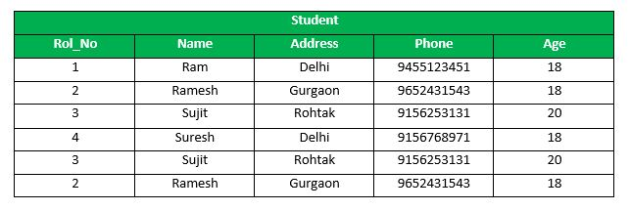
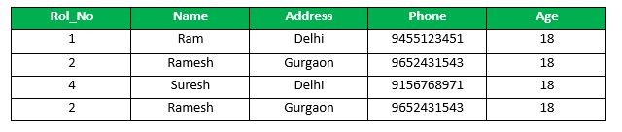
DELETE FROM Student WHERE AGE = 20;
COMMIT;
SELECT * FROM Student;

Slide 34
Rollback: Rollback command is used to undo transactions that have not already been saved to the database.
Syntax:
ROLLBACK;
Example:
DELETE FROM CUSTOMERS
WHERE AGE = 20;
ROLLBACK;

Slide 35
DELETE FROM Student WHERE AGE = 20;
ROLLBACK;

Slide 36
SAVEPOINT: It is used to roll the transaction back to a certain point without rolling back the entire transaction.
Syntax:
SAVEPOINT SAVEPOINT_NAME;
Example:
SAVEPOINT RollNo;

Slide 37
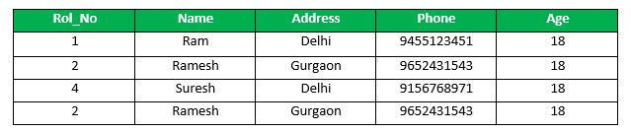
SAVEPOINT SP1;
//Savepoint created.
DELETE FROM Student WHERE AGE = 20;
SAVEPOINT SP2;
//Savepoint created.

Slide 38
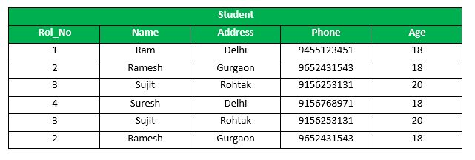
Deletion have been taken place, let us assume that you have changed your mind and decided to ROLLBACK to the SAVEPOINT that you identified as SP1 which is before deletion.
deletion is undone by this statement,
ROLLBACK TO SP1; //Rollback completed.

Slide 39
SQL Set Operation
The SQL Set operation is used to combine the two or more SQL SELECT statements.
The number and order of columns must be the same.
Data types must be compatible.
Types of Set Operation
Union
UnionAll
Intersect
Minus

Slide 40
Union
The SQL Union operation is used to combine the result of two or more SQL SELECT queries.
In the union operation, all the number of datatype and columns must be same in both the tables on which UNION operation is being applied.
The union operation eliminates the duplicate rows from its resultset.
Syntax
SELECT column_name FROM table1
UNION
SELECT column_name FROM table2;

Slide 41
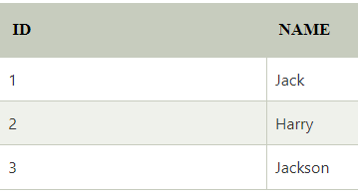
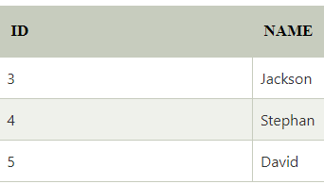
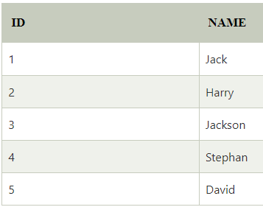
First
Second
SELECT * FROM First
UNION
SELECT * FROM Second;

Slide 42
Union All
Union All operation is equal to the Union operation. It returns the set without removing duplication and sorting the data.
Syntax:
SELECT column_name FROM table1
UNION ALL
SELECT column_name FROM table2;
Example: Using the above First and Second table.
Union All query will be like:
SELECT * FROM First
UNION ALL
SELECT * FROM Second;

Slide 43
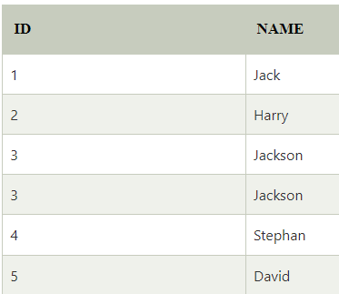
SELECT * FROM First
UNION ALL
SELECT * FROM Second;

Slide 44
Intersect
It is used to combine two SELECT statements. The Intersect operation returns the common rows from both the SELECT statements.
In the Intersect operation, the number of datatype and columns must be the same.
It has no duplicates and it arranges the data in ascending order by default.
Syntax
SELECT column_name FROM table1
INTERSECT
SELECT column_name FROM table2;

Slide 45

SELECT * FROM First
INTERSECT
SELECT * FROM Second;

Slide 46
Minus / Except
It combines the result of two SELECT statements.
Minus operator is used to display the rows which are present in the first query but absent in the second query.
It has no duplicates and data arranged in ascending order by default.
Syntax:
SELECT column_name FROM table1
MINUS
SELECT column_name FROM table2;

Slide 47
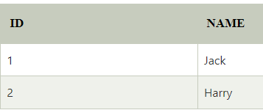
SELECT * FROM First
MINUS
SELECT * FROM Second;

Slide 48
The SQL ORDER BY Keyword
The ORDER BY keyword is used to sort the result-set in ascending or descending order.
The ORDER BY keyword sorts the records in ascending order by default. To sort the records in descending order, use the DESC keyword.
ORDER BY Syntax
SELECT column1, column2, ... FROM table_name ORDER BY column1, column2, ... ASC|DESC;

Slide 49
SELECT * FROM Customers ORDER BY Country;
--------------------------------------------------------------------------------------------------
SELECT * FROM Customers ORDER BY Country DESC;
----------------------------------------------------------------------------------------------------
SELECT * FROM Customers ORDER BY Country, CustomerName;
selects all customers from the "Customers" table, sorted by the "Country" and the "CustomerName" column. This means that it orders by Country, but if some rows have the same Country, it orders them by CustomerName.
--------------------------------------------------------------------------------------------------------
SELECT * FROM Customers ORDER BY Country ASC, CustomerName DESC;

Slide 50
GROUP BY CLAUSE
The SQL GROUP BY clause is used in collaboration with the SELECT statement to arrange identical data into groups. This GROUP BY clause follows the WHERE clause in a SELECT statement and precedes the ORDER BY clause.
The basic syntax of a GROUP BY clause is shown in the following code block. The GROUP BY clause must follow the conditions in the WHERE clause and must precede the ORDER BY clause if one is used.
SELECT column1, column2
FROM table_name
WHERE [ conditions ]
GROUP BY column1, column2
ORDER BY column1, column2

Slide 51
HAVING CLAUSE
The HAVING Clause enables you to specify conditions that filter which group results appear in the results.
The WHERE clause places conditions on the selected columns, whereas the HAVING clause places conditions on groups created by the GROUP BY clause.
The HAVING clause must follow the GROUP BY clause in a query and must also precede the ORDER BY clause if used. The following code block has the syntax of the SELECT statement including the HAVING clause-
SELECT column1, column2
FROM table1, table2
WHERE [ conditions ]
GROUP BY column1, column2
HAVING [ conditions ]
ORDER BY column1, column2

Slide 52
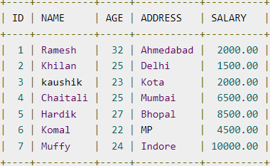
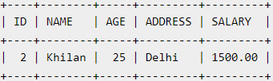
SELECT ID, NAME, AGE, ADDRESS, SALARY
FROM CUSTOMERS
GROUP BY age
HAVING COUNT(age) >= 2

Slide 53
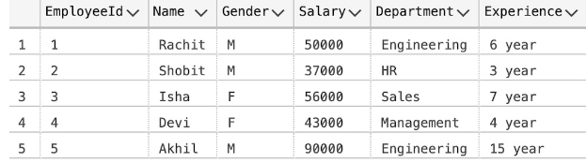
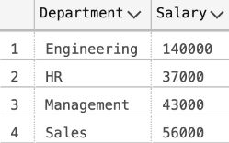
SELECT Department, sum(Salary) as Salary
FROM employee
GROUP BY department ;

Slide 54
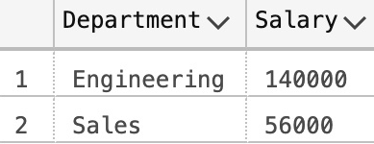
SELECT Department, sum(Salary) as Salary
FROM employee
GROUP BY department
HAVING SUM(Salary) >= 50000;

Slide 55
Aggregate functions in SQL
An aggregate function in SQL performs a calculation on multiple values and returns a single value.
SQL provides many aggregate functions that include avg, count, sum, min, max, etc.
An aggregate function ignores NULL values when it performs the calculation, except for the count function.
We often use aggregate functions with the GROUP BY and HAVING clauses of the SELECT statement.
Various types of SQL aggregate functions are:
Count(), Sum(), Avg(), Min(), Max().

Slide 56
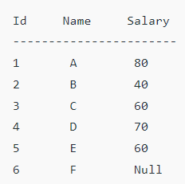
Count():
Count(*): Returns total number of records .i.e 6. Count(salary): Return number of Non Null values over the column salary. i.e 5. Count(Distinct Salary): Return number of distinct Non Null values over the column salary .i.e 4

Slide 57
Sum():
sum(salary): Sum all Non Null values of Column salary i.e., 310
(80+ 40+ 60+ 70+ 60 = 310)
sum(Distinct salary): Sum of all distinct Non-Null values i.e., 250.
(80+ 40+ 60+ 70 = 250)

Slide 58
Avg():
Avg(salary) = Sum(salary) / count(salary) = 310/5
Avg(Distinct salary) = sum(Distinct salary) / Count(Distinct Salary) = 250/4

Slide 59
Min(salary): Minimum value in the salary column except NULL i.e., 40. Max(salary): Maximum value in the salary i.e., 80.

Slide 60
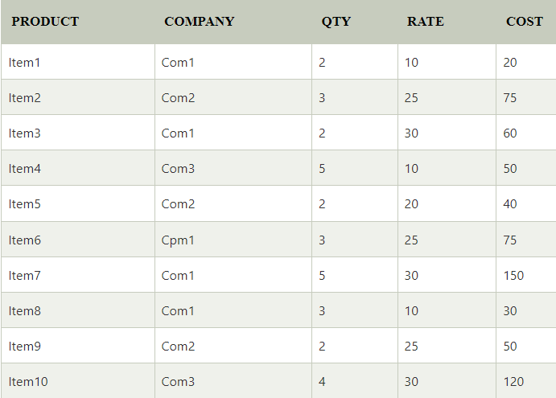

Slide 61
SELECT COUNT(*)
FROM PRODUCT_MAST;
O/P= 10
-----------------------------------------------
SELECT COUNT(*)
FROM PRODUCT_MAST
WHERE RATE>=20;
O/P= 7
-----------------------------------------------
SELECT COUNT(DISTINCT COMPANY)
FROM PRODUCT_MAST;
O/P= 3
-----------------------------------------------
SELECT COMPANY, COUNT(*)
FROM PRODUCT_MAST
GROUP BY COMPANY;
O/P= Com1 5
Com2 3
Com3 2
--------------------------------------------------------
SELECT COMPANY, COUNT(*)
FROM PRODUCT_MAST
GROUP BY COMPANY
HAVING COUNT(*) > 2;
O/P= Com1 5
Com2 3

Slide 62
SELECT SUM(COST)
FROM PRODUCT_MAST;
O/P= 670
---------------------------------------
SELECT SUM(COST)
FROM PRODUCT_MAST
WHERE QTY>3;
O/P= 320
---------------------------------------
SELECT COMPANY, SUM(COST)
FROM PRODUCT_MAST
WHERE QTY>3
GROUP BY COMPANY;
O/P= Com1 150
Com2 170
-------------------------------------------------
SELECT COMPANY, SUM(COST)
FROM PRODUCT_MAST
GROUP BY COMPANY
HAVING SUM(COST)>=170;
O/P= Com1 335
Com3 170

Slide 63
SELECT AVG(COST)
FROM PRODUCT_MAST;
O/P= 67.00
----------------------------------------------------
SELECT MAX(RATE)
FROM PRODUCT_MAST;
O/P= 30
----------------------------------------------------
SELECT MIN(RATE)
FROM PRODUCT_MAST;
O/P= 10

Slide 64
Integrity Constraints
Integrity constraints are a set of rules that the DB not permitted to violate.
It is used to maintain the quality of information.
ensure accuracy and consistency of data in relational table
Integrity constraints ensure that the data insertion, updating, and other processes have to be performed in such a way that data integrity is not affected.
Thus, integrity constraint is used to guard against accidental damage to the database.
Constraint may apply to each attribute or may apply to relationships between tables.

Slide 65
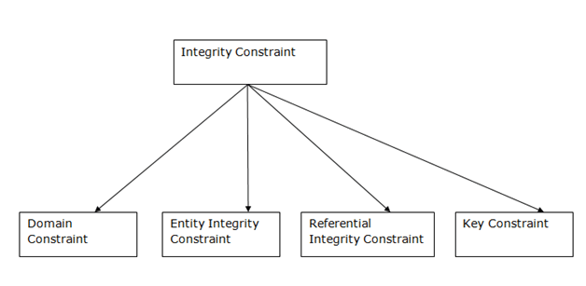
Types of Integrity Constraint
Example: Blood Group must be ‘A’, ‘B’, ‘O’ or ‘AB’. (no any other value)

Slide 66
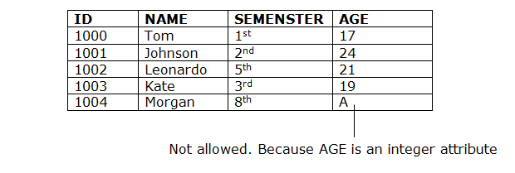
Domain constraints: (attribute)
Domain constraints can be defined as the definition of a valid set of values for an attribute.
The data type of domain includes string, character, integer, time, date, currency, etc. The value of the attribute must be available in the corresponding domain.

Slide 67
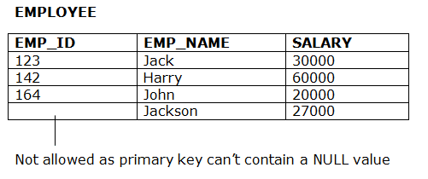
Entity integrity constraints: (attribute)
The entity integrity constraint states that primary key value can't be null.
This is because the primary key value is used to identify individual rows in relation and if the primary key has a null value, then we can't identify those rows.
A table can contain a null value other than the primary key field.

Slide 68
Referential Integrity Constraints: (Relation)
A referential integrity constraint is specified between two tables.
This constraint is enforced when a foreign key references the primary key of the table.
In the Referential integrity constraints, if a foreign key in Table 1 refers to the Primary Key of Table 2, then every value of the Foreign Key in Table 1 must be null or be available in Table 2.

Slide 69
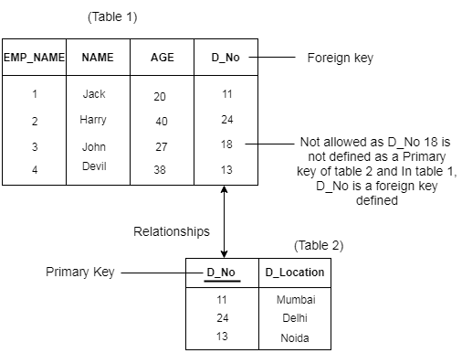
Related / Referencing Table
Primary / Referenced Table

Slide 70
Referential Integrity Constraints Rules:
You can’t insert a value in the foreign key field of related table that does not exists in the primary key of the primary table.
You can enter a NULL value in the foreign key, specifying that the records are unrelated.
You can’t delete a record from primary table if matching record exists in a related table.
You can’t change the primary key value in the primary table if that record has related records.

Slide 71
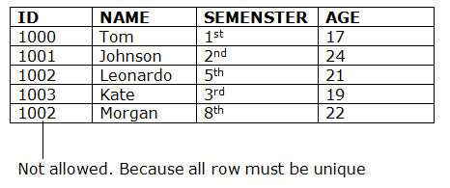
Key constraints: (attribute)
Keys are the entity set that is used to identify an entity within its entity set uniquely.
An entity set can have multiple keys, but out of which one key will be the primary key.
A primary key can contain a unique and null value in the relational table.

Slide 72
CHECK Constraint
The CHECK constraint is used to limit the value range that can be placed in a column.
If you define a CHECK constraint on a column it will allow only certain values for this column.
If you define a CHECK constraint on a table it can limit the values in certain columns based on values in other columns in the row.
Cheks incoming value whether it is according to our parameters or not.

Slide 73
The following SQL creates a CHECK constraint on the "Age" column when the "Persons" table is created. The CHECK constraint ensures that the age of a person must be 18, or older:
CREATE TABLE Persons
( ID int NOT NULL, LastName varchar(255) NOT NULL, FirstName varchar(255), Age int CHECK (Age>=18) );

Slide 74
To allow naming of a CHECK constraint, and for defining a CHECK constraint on multiple columns, use the following SQL syntax:
CREATE TABLE Persons
( ID int NOT NULL, LastName varchar(255) NOT NULL, FirstName varchar(255), Age int, City varchar(255), CONSTRAINT CHK_Person CHECK (Age>=18 AND City=‘Dhule’) );

Slide 75
SQL CHECK on ALTER TABLE
ALTER TABLE Persons ADD CHECK (Age>=18);
ALTER TABLE Persons ADD CONSTRAINT CHK_PersonAge CHECK (Age>=18 AND City='Shirpur');
DROP a CHECK Constraint
ALTER TABLE Persons DROP CONSTRAINT CHK_PersonAge;

Slide 76
CREATE TABLE Persons ( ID number(2) NOT NULL, LastName varchar(255) NOT NULL, FirstName varchar(255) NOT NULL, Age number(2) );

Slide 77
SQL NOT NULL on CREATE TABLE
CREATE TABLE Persons ( ID int NOT NULL, LastName varchar(255) NOT NULL, FirstName varchar(255) NOT NULL, Age int );

Slide 78
SQL UNIQUE Constraint on CREATE TABLE
CREATE TABLE Persons ( ID int NOT NULL UNIQUE, LastName varchar(255) NOT NULL, FirstName varchar(255), Age int );
To name a UNIQUE constraint, and to define a UNIQUE constraint on multiple columns, use the following SQL syntax:
CREATE TABLE Persons ( ID int NOT NULL, LastName varchar(255) NOT NULL, FirstName varchar(255), Age int, CONSTRAINT UC_Person UNIQUE (ID,LastName) );

Slide 79
SQL UNIQUE Constraint on ALTER TABLE
To create a UNIQUE constraint on the "ID" column when the table is already created, use the following SQL:
ALTER TABLE Persons ADD UNIQUE (ID);
To name a UNIQUE constraint, and to define a UNIQUE constraint on multiple columns, use the following SQL syntax:
ALTER TABLE Persons ADD CONSTRAINT UC_Person UNIQUE (ID,LastName);
DROP a UNIQUE Constraint
ALTER TABLE Persons DROP CONSTRAINT UC_Person;

Slide 82
SQL DEFAULT on CREATE TABLE
CREATE TABLE Persons ( ID int NOT NULL, LastName varchar(255) NOT NULL, FirstName varchar(255), Age int, City varchar(255) DEFAULT 'Sandnes' );
DROP a DEFAULT Constraint
ALTER TABLE Persons ALTER COLUMN City DROP DEFAULT;

Slide 83
SQL PRIMARY KEY on CREATE TABLE
CREATE TABLE Persons ( ID int NOT NULL PRIMARY KEY, LastName varchar(255) NOT NULL, FirstName varchar(255), Age int );
There is only ONE PRIMARY KEY (PK_Person). However, the VALUE of the primary key is made up of TWO COLUMNS (ID + LastName).
CREATE TABLE Persons ( ID int NOT NULL, LastName varchar(255) NOT NULL, FirstName varchar(255), Age int, CONSTRAINT PK_Person PRIMARY KEY (ID,LastName) );

Slide 84
DROP a PRIMARY KEY Constraint
ALTER TABLE Persons DROP CONSTRAINT PK_Person;
SQL PRIMARY KEY on ALTER TABLE
To create a PRIMARY KEY constraint on the "ID" column when the table is already created, use the following SQL:
ALTER TABLE Persons ADD PRIMARY KEY (ID);

Slide 85
To allow naming of a PRIMARY KEY constraint, and for defining a PRIMARY KEY constraint on multiple columns, use the following SQL syntax:
ALTER TABLE Persons ADD CONSTRAINT PK_Person PRIMARY KEY (ID,LastName);
If you use ALTER TABLE to add a primary key, the primary key column(s) must have been declared to not contain NULL values (when the table was first created).

Slide 87
SQL FOREIGN KEY on CREATE TABLE
CREATE TABLE Orders ( OrderID int NOT NULL PRIMARY KEY, OrderNumber int NOT NULL, PersonID int FOREIGN KEY REFERENCES Persons(PersonID) );

Slide 88
SQL FOREIGN KEY on ALTER TABLE
To create a FOREIGN KEY constraint on the "PersonID" column when the "Orders" table is already created, use the following SQL:
ALTER TABLE Orders ADD FOREIGN KEY (PersonID) REFERENCES Persons(PersonID);
To allow naming of a FOREIGN KEY constraint, and for defining a FOREIGN KEY constraint on multiple columns, use the following SQL syntax:
ALTER TABLE Orders ADD CONSTRAINT FK_PersonOrder FOREIGN KEY (PersonID) REFERENCES Persons(PersonID);

Slide 89
DROP a FOREIGN KEY Constraint
ALTER TABLE Orders DROP CONSTRAINT FK_PersonOrder;

Slide 91


SQL String Operators
1. Concatenation Operator
The concatenation operation is used to combine character strings, columns of a table or it can also be used for the combination of column and strings.
SELECT 'Hello' + 'World!'
AS StringConcatenated;
SELECT 'Hello' + ' ' + 'World!'
AS StringConcatenated;

Slide 92
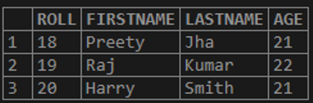
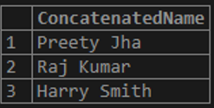
SELECT FIRSTNAME + ' ' + LASTNAME AS ConcatenatedName FROM STUDENTS;

Slide 93
2. Like Operator
This operator is used to decide if the specific character string matches the specific pattern where the pattern can be a regular or wildcard character.
While pattern matching, the regular characters should match exactly with the specific characters of the string but when we want to match the arbitrary fragments of the string, wildcard characters can be used.
The wildcard character used in the below query is % and any sequence of zero or more characters are matched by %.

Slide 94




SELECT * FROM STUDENTS
WHERE FIRSTNAME LIKE ‘P%';
SELECT * FROM STUDENTS
WHERE FIRSTNAME LIKE '%j';
SELECT FIRSTNAME FROM STUDENTS WHERE FIRSTNAME LIKE 'p%y';
SELECT * FROM STUDENTS
WHERE FIRSTNAME LIKE '%a%';

Slide 95


The other wildcard character ‘_’ is used to match any single character. If we want to find any character at a particular position.
Find ‘a’ at the second position in first names.
SELECT FIRSTNAME FROM STUDENTS
WHERE FIRSTNAME LIKE '_a%';
The values of the FIRSTNAME which start with ‘p’ having the character length of at least 2 can be found.
SELECT FIRSTNAME FROM STUDENTS
WHERE FIRSTNAME LIKE ‘P_%';

Slide 96
The concatenation operation and pattern matching in SQL have an important role.
In concatenation operation, the strings and columns can be combined and
In pattern matching, the data value in a column is matched with the specific pattern.
Tran%
%know%
_ _ _
_ _ _%
%001

Slide 97
Function | Description
ASCII | Returns the ASCII value for the specific character
CHAR | Returns the character based on the ASCII code
CHARINDEX | Returns the position of a substring in a string
CONCAT | Adds two or more strings together
Concat with + | Adds two or more strings together
CONCAT_WS | Adds two or more strings together with a separator
DATALENGTH | Returns the number of bytes used to represent an expression
DIFFERENCE | Compares two SOUNDEX values, and returns an integer value
FORMAT | Formats a value with the specified format

Slide 98
Function | Description
LEFT | Extracts a number of characters from a string (starting from left)
LEN | Returns the length of a string
LOWER | Converts a string to lower-case
LTRIM | Removes leading spaces from a string
NCHAR | Returns the Unicode character based on the number code
PATINDEX | Returns the position of a pattern in a string
QUOTENAME | Returns a Unicode string with delimiters added to make the string a valid SQL Server delimited identifier
REPLACE | Replaces all occurrences of a substring within a string, with a new substring
REPLICATE | Repeats a string a specified number of times
REVERSE | Reverses a string and returns the result

Slide 99
Function | Description
RIGHT | Extracts a number of characters from a string (starting from right)
RTRIM | Removes trailing spaces from a string
SOUNDEX | Returns a four-character code to evaluate the similarity of two strings
SPACE | Returns a string of the specified number of space characters
STR | Returns a number as string
STUFF | Deletes a part of a string and then inserts another part into the string, starting at a specified position
SUBSTRING | Extracts some characters from a string

Slide 100
Function | Description
TRANSLATE | Returns the string from the first argument after the characters specified in the second argument are translated into the characters specified in the third argument.
TRIM | Removes leading and trailing spaces (or other specified characters) from a string
UNICODE | Returns the Unicode value for the first character of the input expression
UPPER | Converts a string to upper-case

Slide 101
Views in SQL
Views in SQL are considered as a virtual table.
It is a stored query.
It does not occupy space (memory).
A view also contains rows and columns.
To create the view, we can select the fields from one or more tables present in the database.
A view can either have specific rows based on certain condition or all the rows of a table.
Changes in base table (insert, update, delete) -> reflects in view

Slide 102
Types of Views in SQL
Read-Only
We can not do changes in view
DDL commands are locked
We can apply DML commands
2. Updatable
Changes in view -> reflects to the table
3. Materialized
Client Server Architecture (remote server)
Snapshot (copy of data to local machine)
Actual take space but comparatively less.

Slide 103
Uses of a View : A good database should contain views due to the given reasons:
1. Restricting data access – Views provide an additional level of table security by restricting access to a predetermined set of rows and columns of a table.
2. Hiding data complexity – A view can hide the complexity that exists in a multiple table join.
3. Simplify commands for the user – Views allows the user to select information from multiple tables without requiring the users to actually know how to perform a join.

Slide 104
Uses of a View : 4. Store complex queries – Views can be used to store complex queries.
5. Rename Columns – Views can also be used to rename the columns without affecting the base tables provided the number of columns in view must match the number of columns specified in select statement. Thus, renaming helps to hide the names of the columns of the base tables.
6. Multiple view facility – Different views can be created on the same table for different users.

Slide 105
1. Creating view
A view can be created using the CREATE VIEW statement. We can create a view from a single table or multiple tables.
Syntax:
CREATE VIEW view_name AS
SELECT column1, column2.....
FROM table_name
WHERE condition;

Slide 106
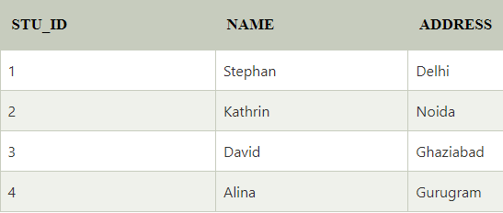
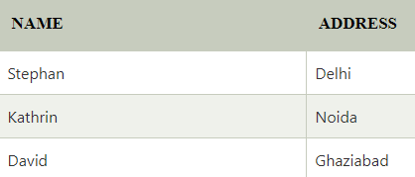
2. Creating View from a single table
We create a View named DetailsView from the table Student_Detail.
CREATE VIEW DetailsView AS
SELECT NAME, ADDRESS
FROM Student_Details
WHERE STU_ID < 4;
SELECT * FROM DetailsView;

Slide 107
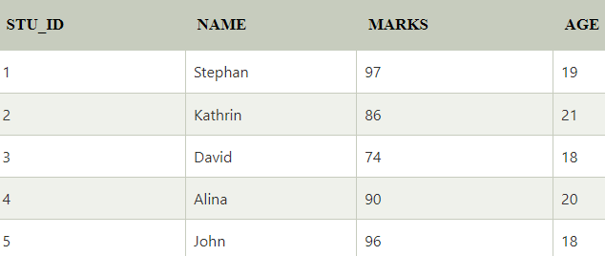
Student_Detail
Student_Marks

Slide 108
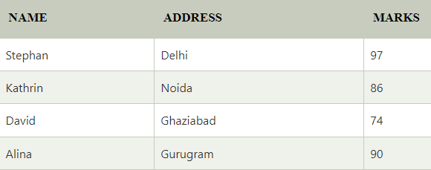
3. Creating View from multiple tables
View from multiple tables can be created by simply include multiple tables in the SELECT statement.
CREATE VIEW MarksView AS
SELECT Student_Detail.NAME, Student_Detail.ADDRESS, Student_Marks.MARKS
FROM Student_Detail, Student_Mark
WHERE Student_Detail.NAME = Student_Marks.NAME;

Slide 109
4. Deleting View
A view can be deleted using the Drop View statement.
Syntax
DROP VIEW view_name;
Example:
DROP VIEW MarksView;

Slide 110
UPDATING VIEWS
There are certain conditions needed to be satisfied to update a view. If any one of these conditions is not met, then we will not be allowed to update the view.
The SELECT statement which is used to create the view should not include GROUP BY clause or ORDER BY clause.
The SELECT statement should not have the DISTINCT keyword.
The View should have all NOT NULL values.
The view should not be created using nested queries or complex queries.
The view should be created from a single table. If the view is created using multiple tables then we will not be allowed to update the view.

Slide 111
We can use the CREATE OR REPLACE VIEW statement to add or remove fields from a view. Syntax:
CREATE OR REPLACE VIEW view_name
AS SELECT column1,coulmn2,..
FROM table_name
WHERE condition;

Slide 112
Inserting a row in a view: We can insert a row in a View in a same way as we do in a table. We can use the INSERT INTO statement of SQL to insert a row in a View.
Syntax:
INSERT INTO view_name(column1, column2 , column3,..)
VALUES(value1, value2, value3..);
Example: we will insert a new row in the View DetailsView which we have created above in the example of “creating views from a single table”.
INSERT INTO DetailsView(NAME, ADDRESS)
VALUES("Suresh","Gurgaon");

Slide 113
Deleting a row from a View: Deleting rows from a view is also as simple as deleting rows from a table. We can use the DELETE statement of SQL to delete rows from a view. Also deleting a row from a view first delete the row from the actual table and the change is then reflected in the view.
Syntax:
DELETE FROM view_name
WHERE condition;
Example:
DELETE FROM DetailsView
WHERE NAME="Suresh“;

Slide 114
WITH CHECK OPTION
The WITH CHECK OPTION clause in SQL is a very useful clause for views. It is applicable to a updatable view. If the view is not updatable, then there is no meaning of including this clause in the CREATE VIEW statement.
The WITH CHECK OPTION clause is used to prevent the insertion of rows in the view where the condition in the WHERE clause in CREATE VIEW statement is not satisfied.
If we have used the WITH CHECK OPTION clause in the CREATE VIEW statement, and if the UPDATE or INSERT clause does not satisfy the conditions then they will return an error.

Slide 115
CREATE VIEW SampleView
AS SELECT S_ID, NAME
FROM StudentDetails
WHERE NAME IS NOT NULL
WITH CHECK OPTION;
In this View if we now try to insert a new row with null value in the NAME column then it will give an error because the view is created with the condition for NAME column as NOT NULL.
INSERT INTO SampleView (S_ID) VALUES(6);
O/P- Error message

Slide 116
SQL Join statement is used to combine data or rows from two or more tables based on a common field (related column) between them. Different types of Joins are as follows:
INNER JOIN:Returns records that have matching values in both tables
LEFT (OUTER) JOIN: Returns all records from the left table, and the matched records from the right table
RIGHT (OUTER) JOIN:Returns all records from the right table, and the matched records from the left table
FULL (OUTER) JOIN: Returns all records when there is a match in either left or right table

Slide 117
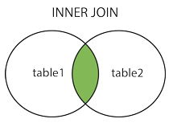
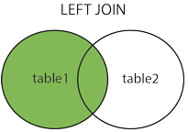
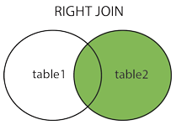
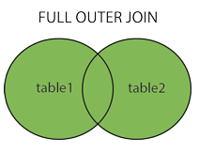

Slide 118
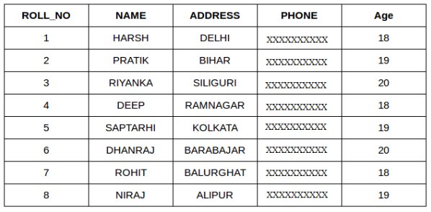
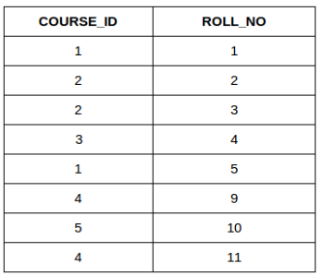
Student
StudentCourse

Slide 119
A. INNER JOIN
The INNER JOIN keyword selects all rows from both the tables as long as the condition is satisfied. This keyword will create the result-set by combining all rows from both the tables where the condition satisfies i.e value of the common field will be the same.
Syntax:
SELECT table1.column1, table1.column2, table2.column1,....
FROM table1
INNER JOIN table2
ON table1.matching_column = table2.matching_column;

Slide 120
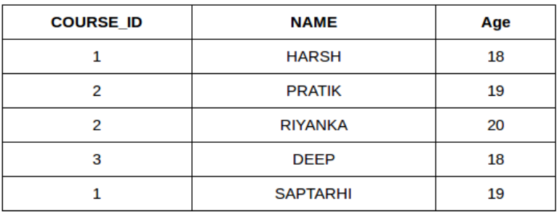
Example Queries(INNER JOIN)
This query will show the names and age of students enrolled in different courses
SELECT StudentCourse.COURSE_ID, Student.NAME, Student.AGE
FROM Student
INNER JOIN StudentCourse
ON Student.ROLL_NO = StudentCourse.ROLL_NO;

Slide 121
B. LEFT JOIN
This join returns all the rows of the table on the left side of the join and matches rows for the table on the right side of the join. For the rows for which there is no matching row on the right side, the result-set will contain null. LEFT JOIN is also known as LEFT OUTER JOIN.
Syntax:
SELECT table1.column1, table1.column2, table2.column1,....
FROM table1
LEFT JOIN table2
ON table1.matching_column = table2.matching_column;

Slide 122
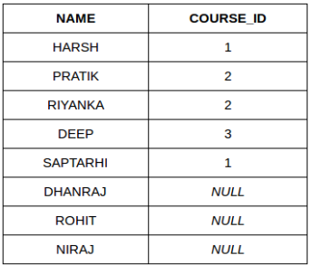
Example Queries(LEFT JOIN):
SELECT Student.NAME,StudentCourse.COURSE_ID
FROM Student
LEFT JOIN StudentCourse
ON StudentCourse.ROLL_NO = Student.ROLL_NO;
Output:

Slide 123
C. RIGHT JOIN
RIGHT JOIN is similar to LEFT JOIN. This join returns all the rows of the table on the right side of the join and matching rows for the table on the left side of the join. For the rows for which there is no matching row on the left side, the result-set will contain null. RIGHT JOIN is also known as RIGHT OUTER JOIN.
Syntax:
SELECT table1.column1,table1.column2,table2.column1,....
FROM table1
RIGHT JOIN table2
ON table1.matching_column = table2.matching_column;

Slide 124
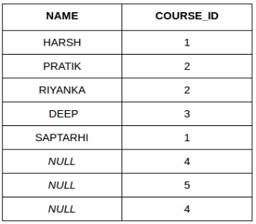
Example Queries(RIGHT JOIN):
SELECT Student.NAME, StudentCourse.COURSE_ID
FROM Student
RIGHT JOIN StudentCourse
ON StudentCourse.ROLL_NO = Student.ROLL_NO;
Output:

Slide 125
D. FULL JOIN
FULL JOIN creates the result-set by combining results of both LEFT JOIN and RIGHT JOIN. The result-set will contain all the rows from both tables. For the rows for which there is no matching, the result-set will contain NULL values.
Syntax:
SELECT table1.column1, table1.column2, table2.column1,....
FROM table1
FULL JOIN table2
ON table1.matching_column = table2.matching_column;

Slide 126
Example Queries(FULL JOIN):
SELECT Student.NAME,StudentCourse.COURSE_ID
FROM Student
FULL JOIN StudentCourse
ON StudentCourse.ROLL_NO = Student.ROLL_NO;
Output:
NAME | COURSE_ID
HARSH | 1
PRATIK | 2
RIYANKA | 2
DEEP | 3
SAPTARHI | 1
DHANRAJ | NULL
ROHIT | NULL
NIRAJ | NULL
NULL | 4
NULL | 5
NULL | 4

Slide 127
SELECT * FROM Customers WHERE Country='Germany' AND City='Berlin';
SELECT * FROM Customers WHERE City='Berlin' OR City='München';
SELECT * FROM Customers WHERE Country='Germany' OR Country='Spain';
SELECT * FROM Customers WHERE Country='Germany' AND (City='Berlin' OR City='München');
SELECT * FROM Customers WHERE NOT Country='Germany' AND NOT Country='USA';

Slide 128
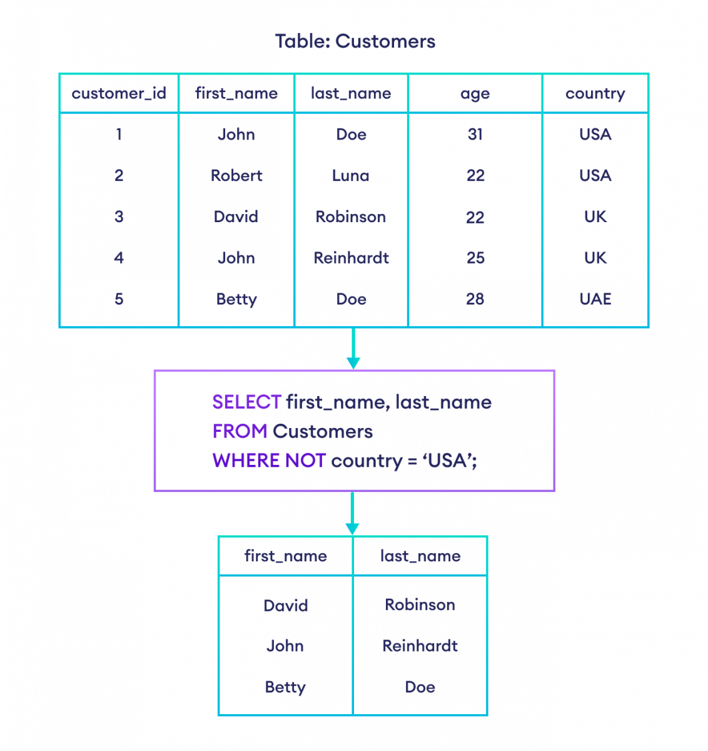

Slide 129
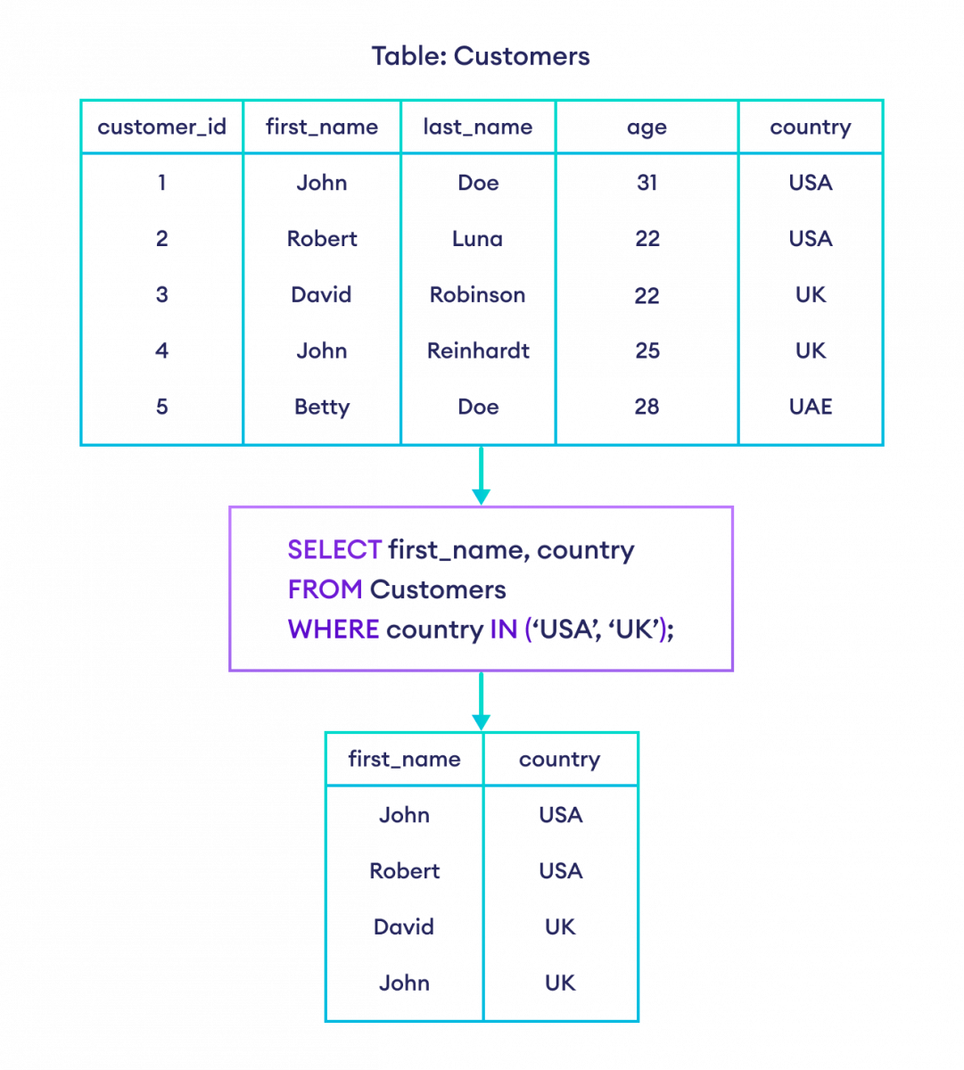

Slide 130
PL/SQL Introduction
PL/SQL is a block structured language that enables developers to combine the power of SQL with procedural statements.
All the statements of a block are passed to oracle engine all at once which increases processing speed and decreases the traffic.
Disadvantages of SQL:
SQL doesn’t provide the programmers with a technique of condition checking, looping and branching.
SQL statements are passed to Oracle engine one at a time which increases traffic and decreases speed.
SQL has no facility of error checking during manipulation of data.

Slide 131
Features of PL/SQL:
PL/SQL is basically a procedural language, which provides the functionality of decision making, iteration and many more features of procedural programming languages.
PL/SQL can execute a number of queries in one block using single command.
One can create a PL/SQL unit such as procedures, functions, packages, triggers, and types, which are stored in the database for reuse by applications.
PL/SQL provides a feature to handle the exception which occurs in PL/SQL block known as exception handling block.
Applications written in PL/SQL are portable to computer hardware or operating system where Oracle is operational.
PL/SQL Offers extensive error checking.

Slide 132
SQL | PL/SQL
SQL is a single query that is used to perform DML and DDL operations. | PL/SQL is a block of codes that used to write the entire program blocks/ procedure/ function, etc.
It is declarative, that defines what needs to be done, rather than how things need to be done. | PL/SQL is procedural that defines how the things needs to be done.
Execute as a single statement. | Execute as a whole block.
Mainly used to manipulate data. | Mainly used to create an application.
Cannot contain PL/SQL code in it. | It is an extension of SQL, so it can contain SQL inside it.

Slide 133
Structure of PL/SQL Block:
PL/SQL extends SQL by adding constructs found in procedural languages, resulting in a structural language that is more powerful than SQL.
The basic unit in PL/SQL is a block.
All PL/SQL programs are made up of blocks, which can be nested within each other.
Typically, each block performs a logical action in the program.
A block has the following structure:
DECLARE declaration statements;
BEGIN executable statements
EXCEPTIONS exception handling statements
END;

Slide 134
SQL> SET SERVEROUTPUT ON;
SQL> DECLARE
-- taking input for variable a
a number := &a;
-- taking input for variable b
b varchar2(30) := &b;
BEGIN
null;
END;
/
Output:
Enter value for a: 24
old 2: a number := &a;
new 2: a number := 24;
Enter value for b: ‘Hello'
old 3: b varchar2(30) := &b;
new 3: b varchar2(30) := ‘Hello';
PL/SQL procedure successfully completed.

Slide 135
Explanation:
SET SERVEROUTPUT ON: It is used to display the buffer used by the dbms_output.
var1 INTEGER : It is the declaration of variable, named var1 which is of integer type. There are many other data types that can be used like float, int, real, smallint, long etc. It also supports variables used in SQL as well like NUMBER(prec, scale), varchar, varchar2 etc.
PL/SQL procedure successfully completed.: It is displayed when the code is compiled and executed successfully.
Slash (/) after END;: The slash (/) tells the SQL*Plus to execute the block.

Slide 136
--PL/SQL code to print sum of two numbers taken from the user.
SQL> SET SERVEROUTPUT ON;
SQL> DECLARE
-- taking input for variable a
a integer := &a ;
-- taking input for variable b
b integer := &b ;
c integer ;
BEGIN
c := a + b ;
dbms_output.put_line('Sum of '||a||' and '||b||' is = '||c);
END;
/
Enter value for a: 2
Enter value for b: 3
Sum of 2 and 3 is = 5
PL/SQL procedure successfully completed.

Slide 137
PL/SQL subprograms are named PL/SQL blocks that can be invoked with a set of parameters. PL/SQL provides two kinds of subprograms −
Functions − These subprograms return a single value; mainly used to compute and return a value.
Procedures − These subprograms do not return a value directly; mainly used to perform an action.
CREATE [OR REPLACE] PROCEDURE procedure_name
[(parameter_name [IN | OUT | IN OUT] type [, ...])]
{IS | AS}
BEGIN < procedure_body >
END procedure_name;
CREATE OR REPLACE PROCEDURE greetings
AS
BEGIN
dbms_output.put_line('Hello World!');
END;
/

Slide 138
SQL subqueries are a powerful tool. They allow us to perform tasks more efficiently by having only one query instead of several.
Subqueries can return single values or tables (with one or many rows and columns).
You can include a subquery:
In the WHERE clause, to filter data.
In the FROM clause, to specify a new table.
In the SELECT clause, to specify a certain column.
In the HAVING clause, as a group selector.
Subqueries should always be enclosed in parentheses ().
Different database management systems have certain limitations on the number of subquery levels (e.g. up to 32 levels in SQL Server).
Subqueries are often computationally inefficient. Thus, I recommend avoiding nested queries when other options are available (e.g. JOINs).

Slide 139
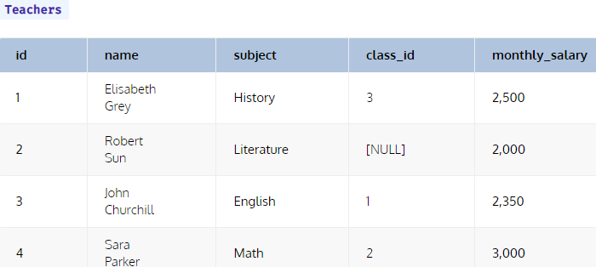
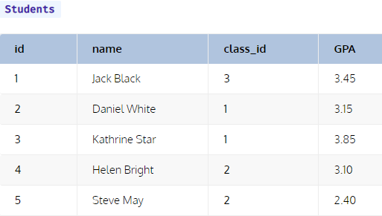
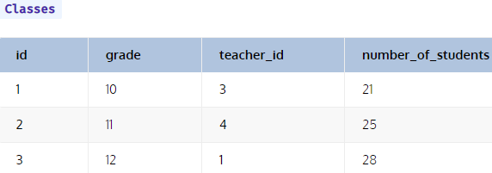

Slide 140
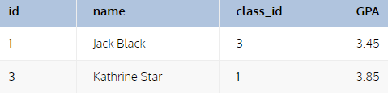
SELECT *
FROM students
WHERE GPA > (
SELECT AVG(GPA)
FROM students );
SELECT AVG(number_of_students)
FROM classes
WHERE teacher_id IN (
SELECT id
FROM teachers
WHERE subject = 'English' OR subject = 'History‘ );
SELECT *
FROM students
WHERE class_id = (
SELECT id
FROM classes
WHERE number_of_students = (
SELECT MAX (number_of_students)
FROM classes)
);

Slide 141

SELECT subject, MAX(salary_by_subject.avg_salary) AS max_salary
FROM (
SELECT subject, AVG(monthly_salary) AS avg_salary
FROM teachers
GROUP BY subject) salary_by_subject;

